Slide 1


Pattern QUBOs

Slide 2
Pattern QUBOS: The Idea
${Φ= (x}_{1}∨x_{2}∨x_{3})∧(x_{1}∨{−x}_{2}∨x_{4})∧(x_{1}∨x_{2}∨x_{4})$ $∧(x_{2}∨{−x}_{4}∨x_{3})$
QUBO 1
QUBO 2
QUBO 3
QUBO 4
Combine
3-SAT QUBO

Slide 3
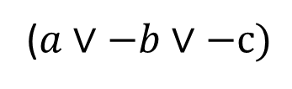
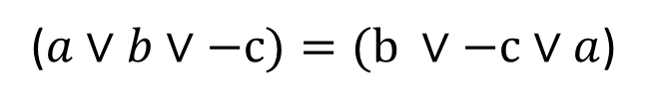
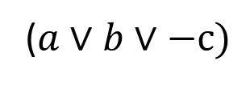

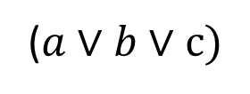


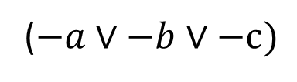
Pattern QUBOs: Clause types
$$Observation$$
$$Clause Types$$
All permutations of the variables within a clause are equal, i.e.:
Type 0:
Type 1:
Type 2:
Type 3:
($a$ $∨b∨c)$
($a$ $∨b∨−c)=(\text{b} ∨−c∨a$)
($a$ $∨b∨−c)$
$$thus$$
($a$ $∨−b∨−c)$
Assume that negated variables are always at the end of the clause
($−a$ $∨−b∨−c)$

Slide 4


Pattern QUBOs: Transform Clauses to QUBO
$$Conditions$$
$$Goal$$
All 7 satisfying assingments of a clause need to correspond to the lowest energy of a QUBO representing the clause
Find 4 x 4 QUBOs that satisfy these 2 conditions.
 | a | b | c | Ancilla
a | Q₁ | Q₂ | Q₃ | Q₄
b |  | Q₅ | Q₆ | Q₇
c |  |  | Q₈ | Q₉
Ancilla |  |  |  | Q₁₀
The one non-satisfying assingment of a clause needs to have a higher energy than all satisfying assignments
Why 4 x 4? It is not possible to satisfy these conditions with a 3 x 3 QUBO.

Slide 5
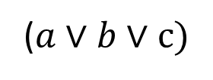
Pattern QUBOs: Energy of an assignment
A clause has 3 variables.
Each 3-SAT variable assignment corresponds to multiple QUBO bit strings.
($a$ $∨b∨c)$
Example:
The 3-SAT variable assignment: a = 0, b = 0, c = 0
A QUBO for this clause has at least 4 variables:
corresponds to
 | a | b | c | Ancilla
a | Q₁ | Q₂ | Q₃ | Q₄
b |  | Q₅ | Q₆ | Q₇
c |  |  | Q₈ | Q₉
Ancilla |  |  |  | Q₁₀
QUBO bit string 1: a = 0, b = 0, c = 0, Ancilla = 0
QUBO bit string 2: a = 0, b = 0, c = 0, Ancilla = 1
Energy of an assignment:
Minimum Energy of all the corresponding QUBO bit strings.

Slide 6


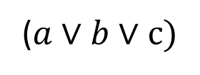
Pattern QUBOs: Transform Clauses to QUBOs
$$Example$$
$$Algorithm Input/Output$$
($a$ $∨b∨c)$
Type 0 clause:
Set of values to choose: {-2, 1}
Result:
Satisfying assignments:
a = 0, b = 0, c = 1
a = 0, b = 1, c = 0
a = 0, b = 1, c = 1
a = 1, b = 0, c = 0
a = 1, b = 0, c = 1
a = 1, b = 1, c = 0
a = 1, b = 1, c = 1
Not Satisfying assignment
a = 0, b = 0, c = 0
 | a | b | c | Ancilla
a | -2 | 1 | 1 | 1
b |  | -2 | 1 | 1
c |  |  | -2 | 1
Ancilla |  |  |  | -2
Must have the
same (minimal) energy
(Condition 1)
All satisfying assignments have energy: -3
The only non-satisfying assignment has energy: 0
Must have a higher energy
(Condition 2)

Slide 7
Create new 3SAT-to-QUBO transformations
Type 0 clause
Type 1 clause
Type 2 clause
Type 3 clause
Algorithm
Algorithm
Algorithm
Algorithm
Set of QUBO representations of the type 0 clause (many!)
Set of QUBO representations of the type 1 clause (many!)
Set of QUBO representations of the type 2 clause (many!)
Set of QUBO representations of the type 3 clause (many!)
New transformation: 4-Tuple (R₀, R₁, R₂, R₃,). R_{i} is one (arbitrarily chosen) QUBO representation from the set of QUBO representations of the respective clause type.

Slide 8
Pattern QUBOS: Apply Type 0-4 QUBOs
${Φ= (x}_{1}∨x_{2}∨x_{3})∧(x_{1}∨x_{2}∨{−x}_{4})∧(x_{1}∨x_{2}∨x_{4})$ $∧(x_{2}∨{−x}_{4}∨{−x}_{3})$
Type 0
QUBO (R₀)
Type 1
QUBO (R₁)
Type 0
QUBO (R₀)
Type 2
QUBO (R₂)
Combine
3-SAT QUBO

Slide 9
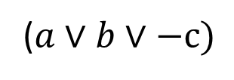
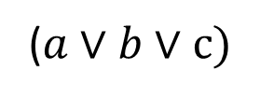
Example (Assume only 2 types of clauses)
Type 0 clause QUBOs
($a$ $∨b∨c)$
Type 1 clause QUBOs
($a$ $∨b∨−c)$
 | a | b | c | Ancilla
a | -2 | 1 | 1 | 1
b |  | -2 | 1 | 1
c |  |  | -2 | 1
Ancilla |  |  |  | -2
 | a | b | c | Ancilla
a | -1 | 1 | 0 | 1
b |  | -1 | 0 | 1
c |  |  | 0 | 1
Ancilla |  |  |  | -1
Qubo 0 =
Qubo 2 =
 | a | b | c | Ancilla
a |  | 2 |  | -2
b |  |  |  | -2
c |  |  | -1 | 1
Ancilla |  |  |  | 1
 | a | b | c | Ancilla
a |  | 2 |  | -2
b |  |  |  | -2
c |  |  | 1 | -1
Ancilla |  |  |  | 2
Qubo 1 =
Qubo 3 =
Valid transformations: (QUBO 0, QUBO2), (QUBO 0, QUBO 3), (QUBO 1, QUBO2), (QUBO 1, QUBO 3)

Slide 10

Example (Assume only 2 types of clauses)
$${Φ= (x}_{1}∨x_{2}∨x_{3})∧(x_{1}∨x_{2}∨{−x}_{4})∧(x_{1}∨x_{2}∨x_{4})$$
Choose: (QUBO 0, QUBO 2) as transformation
$${ (x}_{1}∨x_{2}∨x_{3})$$
$$(x_{1}∨x_{2}∨{−x}_{4})$$
$$(x_{1}∨x_{2}∨x_{4})$$
 | x₁ | x₂ | x₃ | Ancilla
x₁ | -2 | 1 | 1 | 1
x₂ |  | -2 | 1 | 1
x₃ |  |  | -2 | 1
Ancilla |  |  |  | -2
 | x₁ | x₂ | x₄ | Ancilla
x₁ | -1 | 1 | 0 | 1
x₂ |  | -1 | 0 | 1
x₄ |  |  | 0 | 1
Ancilla |  |  |  | -1
 | x₁ | x₂ | x₄ | Ancilla
x₁ | -2 | 1 | 1 | 1
x₂ |  | -2 | 1 | 1
x₄ |  |  | -2 | 1
Ancilla |  |  |  | -2

Slide 11
Example (Assume only 2 types of clauses)
 | x₁ | x₂ | x₃ | A1
x₁ | -2 | 1 | 1 | 1
x₂ |  | -2 | 1 | 1
x₃ |  |  | -2 | 1
A1 |  |  |  | -2
 | x₁ | x₂ | x₃ | x₄ | A1 | A2 | A3
x₁ | -2 -1 -2 | 1 + 1 + 1 | 1 | 0 + 1 | 1 | 1 | 1
x₂ |  | -2 -1 -2 | 1 | 0 + 1 | 1 | 1 | 1
x₃ |  |  | -2 |  | 1
x₄ |  |  |  | 0 -2 |  | 1 | 1
A1 |  |  |  |  | -2
A2 |  |  |  |  |  | -1
A3 |  |  |  |  |  |  | -2
 | x₁ | x₂ | x₄ | A2
x₁ | -1 | 1 | 0 | 1
x₂ |  | -1 | 0 | 1
x₄ |  |  | 0 | 1
A2 |  |  |  | -1
 | x₁ | x₂ | x₄ | A3
x₁ | -2 | 1 | 1 | 1
x₂ |  | -2 | 1 | 1
x₄ |  |  | -2 | 1
A3 |  |  |  | -2

Slide 12
Example (Assume only 2 types of clauses)
$${Φ= (x}_{1}∨x_{2}∨x_{3})∧(x_{1}∨x_{2}∨{−x}_{4})∧(x_{1}∨x_{2}∨x_{4})$$
Choose: (QUBO 1, QUBO 2) as transformation
$${ (x}_{1}∨x_{2}∨x_{3})$$
$$(x_{1}∨x_{2}∨{−x}_{4})$$
$$(x_{1}∨x_{2}∨x_{4})$$
 | x₁ | x₂ | x₃ | Ancilla
x₁ |  | 2 |  | -2
x₂ |  |  |  | -2
x₃ |  |  | -1 | 1
Ancilla |  |  |  | 1
 | x₁ | x₂ | x₄ | Ancilla
x₁ | -1 | 1 | 0 | 1
x₂ |  | -1 | 0 | 1
x₄ |  |  | 0 | 1
Ancilla |  |  |  | -1
 | x₁ | x₂ | x₄ | Ancilla
x₁ |  | 2 |  | -2
x₂ |  |  |  | -2
x₄ |  |  | -1 | 1
Ancilla |  |  |  | 1

Slide 13
Example (Assume only 2 types of clauses)
 | x₁ | x₂ | x₃ | A1
x₁ |  | 2 |  | -2
x₂ |  |  |  | -2
x₃ |  |  | -1 | 1
A1 |  |  |  | 1
 | x₁ | x₂ | x₃ | x₄ | A1 | A2 | A3
x₁ | -1 | 2 -1 +2 |  | 0 | -2 | 1 | -2
x₂ |  | -1 | 0 |  | -2 | 1 | -2
x₃ |  |  | -1 |  | 1
x₄ |  |  |  | 0 -1 |  | 1 | 1
A1 |  |  |  |  | 1
A2 |  |  |  |  |  | -1
A3 |  |  |  |  |  |  | 1
 | x₁ | x₂ | x₄ | A2
x₁ | -1 | 1 | 0 | 1
x₂ |  | -1 | 0 | 1
x₄ |  |  | 0 | 1
A2 |  |  |  | -1
 | x₁ | x₂ | x₄ | A3
x₁ |  | 2 |  | -2
x₂ |  |  |  | -2
x₄ |  |  | -1 | 1
A3 |  |  |  | 1

Slide 14
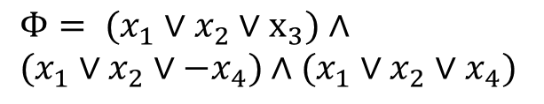
Comparison
 | x₁ | x₂ | x₃ | x₄ | A1 | A2 | A3
x₁ | -2 -1 -2 | 1 + 1 + 1 | 1 | 0 + 1 | 1 | 1 | 1
x₂ |  | -2 -1 -2 | 1 | 0 + 1 | 1 | 1 | 1
x₃ |  |  | -2 |  | 1
x₄ |  |  |  | 0 -2 |  | 1 | 1
A1 |  |  |  |  | -2
A2 |  |  |  |  |  | -1
A3 |  |  |  |  |  |  | -2
Both QUBOs can be used to calculate solutions for the 3SAT-formula:
$${Φ= (x}_{1}∨x_{2}∨x_{3})∧ \\ (x_{1}∨x_{2}∨{−x}_{4})∧(x_{1}∨x_{2}∨x_{4})$$
They differ however in the amount of non-zero couplers and in their magnitude of the linear/quadratic values.
 | x₁ | x₂ | x₃ | x₄ | A1 | A2 | A3
x₁ | -1 | 2 -1 +2 |  | 0 | -2 | 1 | -2
x₂ |  | -1 | 0 |  | -2 | 1 | -2
x₃ |  |  | -1 |  | 1
x₄ |  |  |  | 0 -1 |  | 1 | 1
A1 |  |  |  |  | 1
A2 |  |  |  |  |  | -1
A3 |  |  |  |  |  |  | 1
May have an impact on the solution quality.

Slide 15

Let's get into the code ...

Slide 16

Let's get into the code ... after the break

